Slide 1


Capstone Project Phase 1
Enhancement of the K-mismatch search algorithm
Via tree data-structures
(Project n. : 22-1-R-15)
Sameer Kandeel
Arkan Mohamad
Supervisor:
Dr. Zakharia Frenkel
1

Slide 2

Introduction
01
The K-Mismatch problem deals with finding positions
in a given text, which may contain words similar to
a given search word.
02
Similarity measure will be defined using the Hamming Distance.
2

Slide 3


What is Hamming Distance ?
What is k-mismatch search problem?
Example :
T=SAMEER
P=SAPEER
HAM(T,P) = 1.
finding any word in the text that differs with up to K litters from the targeted word.
3

Slide 4




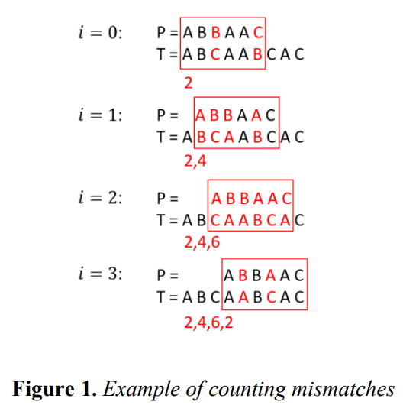
Naïve Algorithm of K-Mismatch
Input: Output:
P = ABBAAC. Matching Positions
T = ABCAABCAC. T[0] , T[3].
K = 2.
4

Slide 5



Basic Algorithm of K-Mismatch
Input :
-Text file
-Form size
-Word size
-Amount of required Matches
Calculate the number of allowed mismatches and create all possible combinations
Using the set of created combinations , create a set of configuration where configuration size = word size.
5

Slide 6
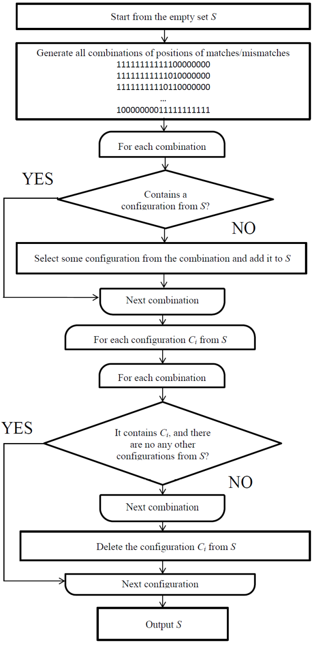
Building the “ MCS “
Basic Algorithm of K-Mismatch
6

Slide 7

Mapping the text
Basic Algorithm of K-Mismatch
After building the MCS , we take each configuration and map all the words in the text using it , so each configuration will have a map , and each map will contain all of the text words and each map is the size of the text.
7

Slide 8

Requirements of the algorithm
There are two main parameters of the MCS quality:
1-required RAM for mapping.
2- search speed.
8

Slide 9

Areas of improvement
creating a MCS with significantly big configurations compared to a relatively small.
- optimizing the algorithm and exclude unnecessary comparisons to improve the search speed .
9

Slide 10

Our Idea !
Building a data-structure that can map all the words from all the configurations in the text.
- The data-structure consists of a dynamic-tree data structure and a dynamic-array.
10

Slide 11
Our Idea !
Firstly we build a tree that contains all of the configurations (before mapping the words from the text).
NOTE :
In this example , each “x” is represented by one node , but actually , each “x” is a set of nodes , each node represents a letter from the used alphabet + “ – “.
11

Slide 12

Our Idea !
A zoom-in into an “x” , where the alphabet is { A , B }.
Each node (letter) of the tree has a pointer to a previous node , a key value , an index (pointer) to it`s position in the dynamic-array and an array of pointers (the size of the alphabet) to the next node.
12

Slide 13

Our Idea !
- When mapping the words , the algorithm links the nodes as needed.
- NOTE : a group of nodes “X” where each alphabetical letter appears one time , is called a NODE SET .
- We call the tree we have dynamic because at any given time , the algorithm may decide to add a new NODE SET .
13

Slide 14
Our Idea !
Example of mapping:
Text : “ABBA”
MCS : { XXX , XX-X }
Words to be mapped : {ABB , AB-A , BBA}
14

Slide 15
Our Idea !
Example of a successful search:
Text : “ABBA”
MCS : { XXX , XX-X }
Words to be mapped : {ABB , AB-A , BBA}
Search Word : BBA
Result : index = 2.
15

Slide 16
Our Idea !
Example of an unsuccessful search:
Text : “ABBA”
MCS : { XXX , XX-X }
Words to be mapped : {ABB , AB-A , BBA}
Search Word : BBB
Result : index = null.
16

Slide 17

Our Idea !
In unsuccessful search we can exclude all of the configurations that have the same prefix :
- we save time
-withdraw from performing many unnecessary comparisons.
17

Slide 18

Our Expectations
-We think that this method provides a significant improvement over the basic algorithm of the k-mismatch problem.
-We expect a dramatic improvement in the speed of search when long configurations are used for relatively short texts , as a result of that , we expect this method to be implemented with every application of the basic algorithm.
18

Slide 19
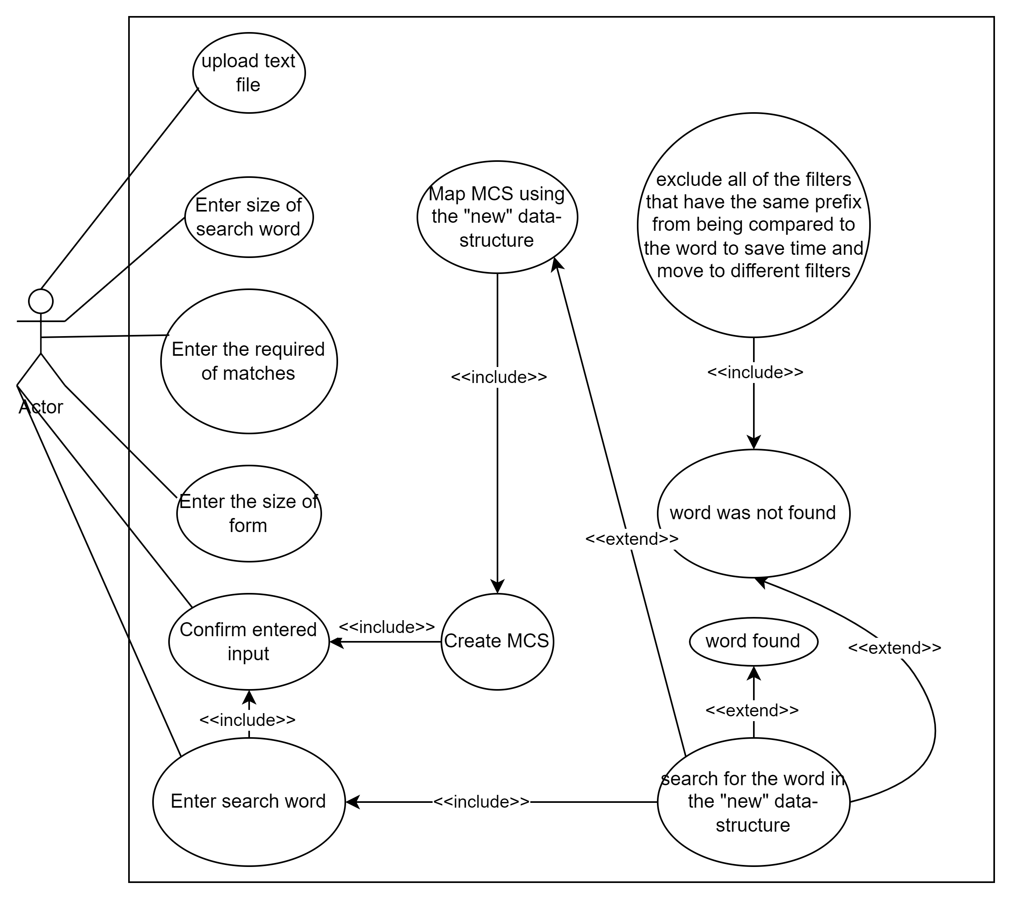
Use-Case Diagram
19

Slide 20
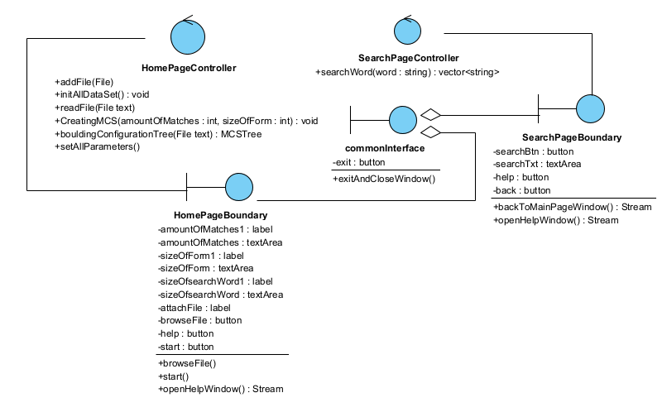
Class Diagram
Screens (Controllers and Boundaries):
20

Slide 21
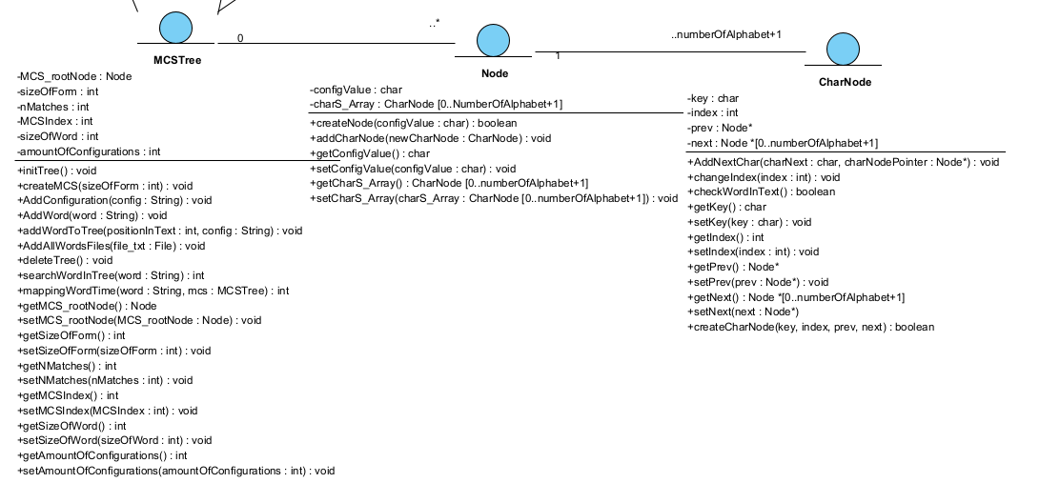
Class Diagram
Data-Structue Tree :
21

Slide 22
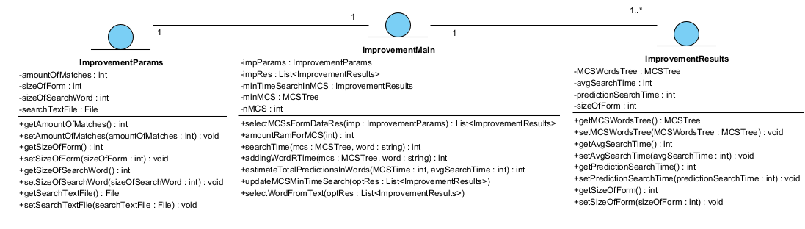
Class Diagram
Main, Results and evaluations:
22

Slide 23
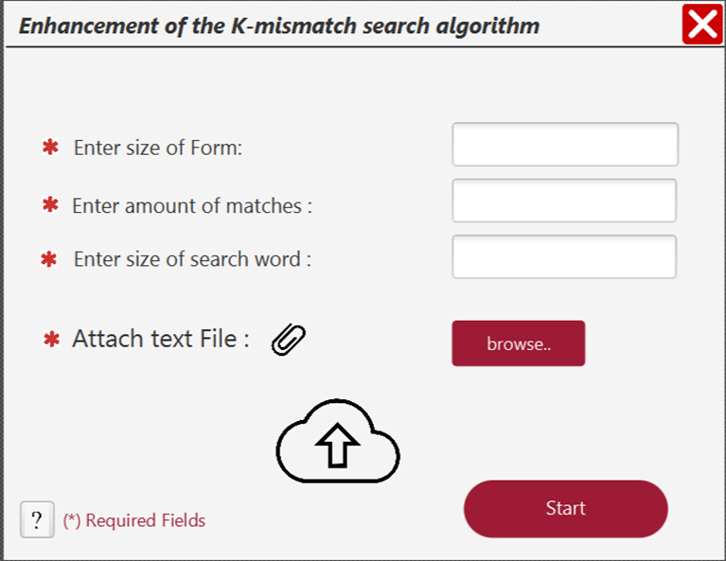
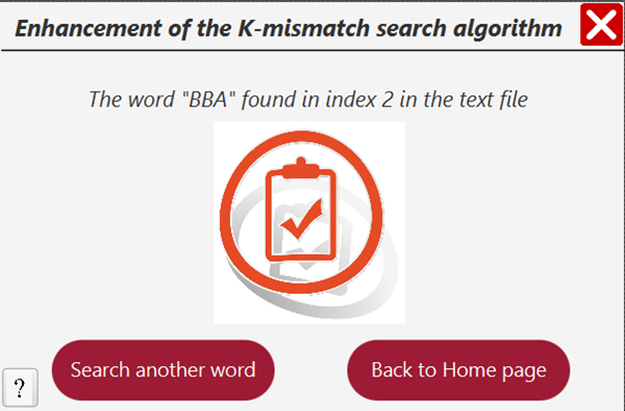
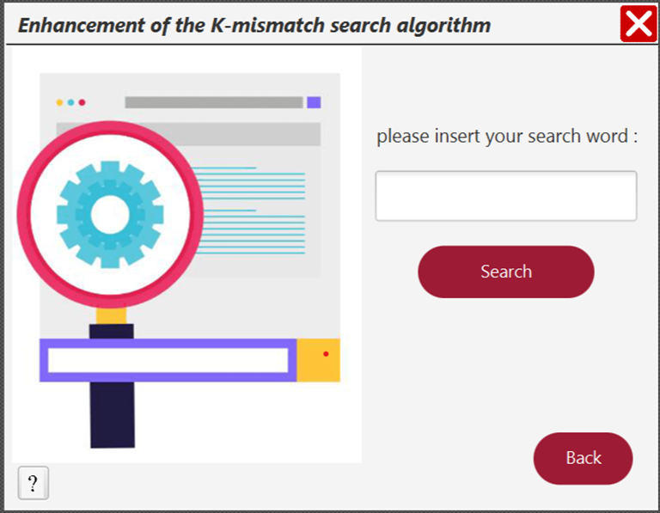
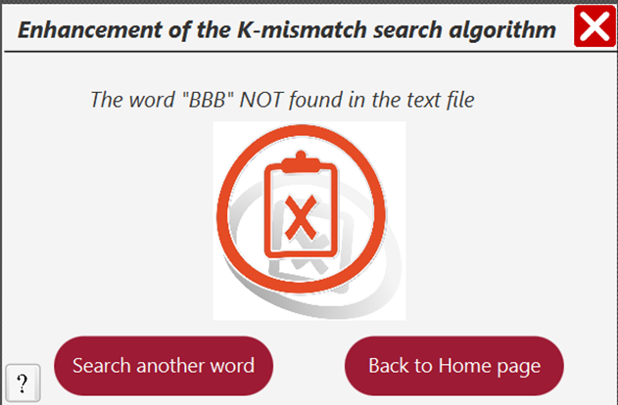
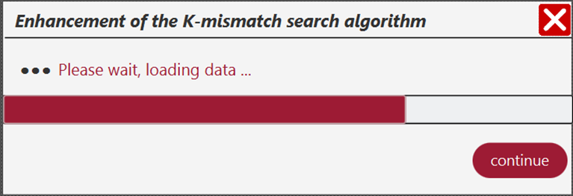
GUI
23

Slide 24

Basic Tests
Test name | Description | Expected results
Successful Search | User Search a word found in the text | Show message “word found in index i”
Unsuccessful Search | User Search a word not found in the text | Show message “word NOT found!”
Evaluate search speed | compare search speeds between basic algorithm and our algorithm | Our algorithm is faster by more than 1000 times
24

Slide 25

Thank You
For Listening ;)
25

